Slide 1
Generation and Demodulation of Frequency Modulated Signals
Gaurav S. Kasbekar
Dept. of Electrical Engineering
IIT Bombay

Slide 2
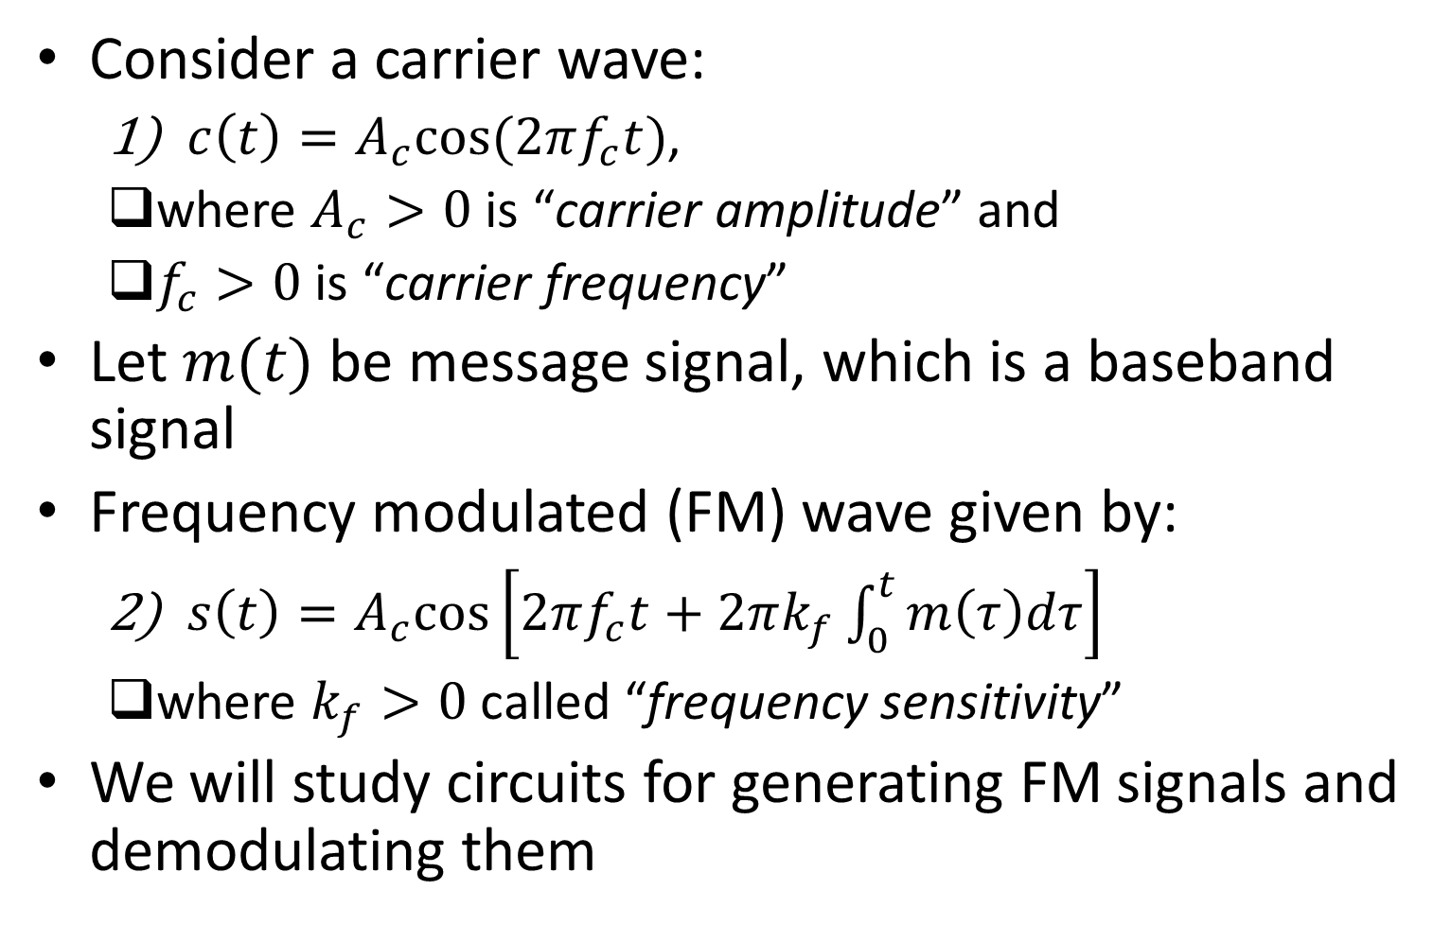
Introduction
Consider a carrier wave:
$c\left(t\right)=A_{c}cos⁡(2πf_{c}t)$,
where $A_{c}>0$ is “carrier amplitude” and
$f_{c}>0$ is “carrier frequency”
Let $m(t)$ be message signal, which is a baseband signal
Frequency modulated (FM) wave given by:
$s\left(t\right)=A_{c}cos\left[2πf_{c}t+2πk_{f}\int_{0}^{t}{m\left(τ\right)dτ}\right]$
where $k_{f}>0$ called “frequency sensitivity”
We will study circuits for generating FM signals and demodulating them

Slide 3
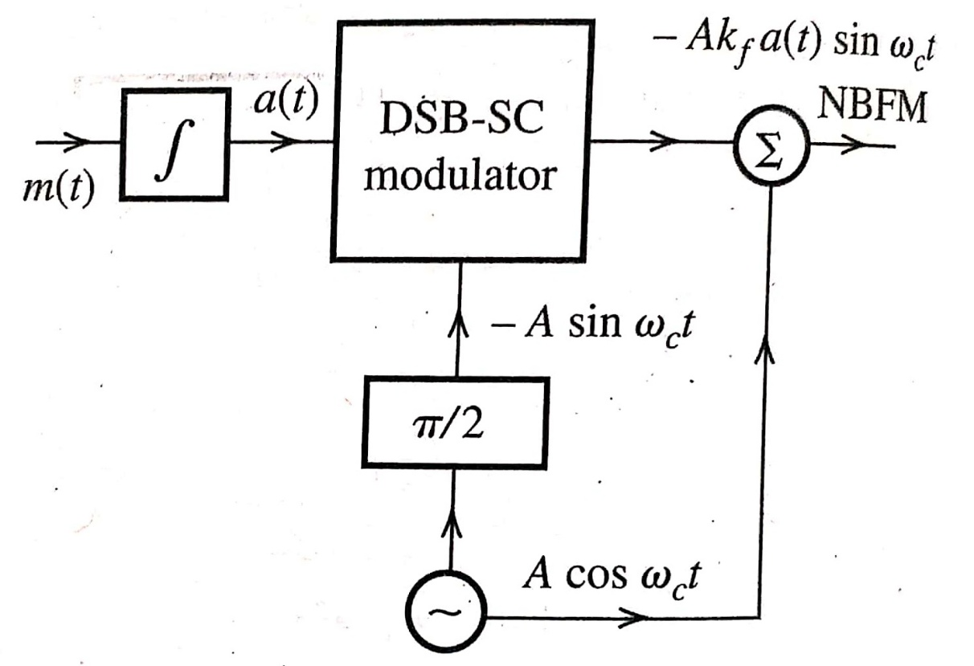
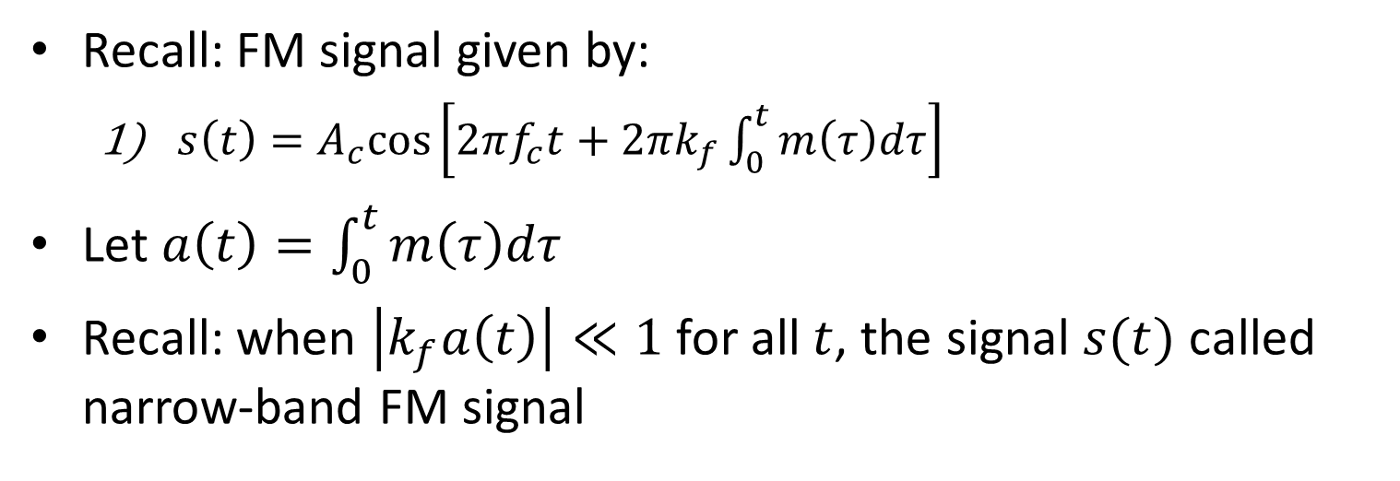
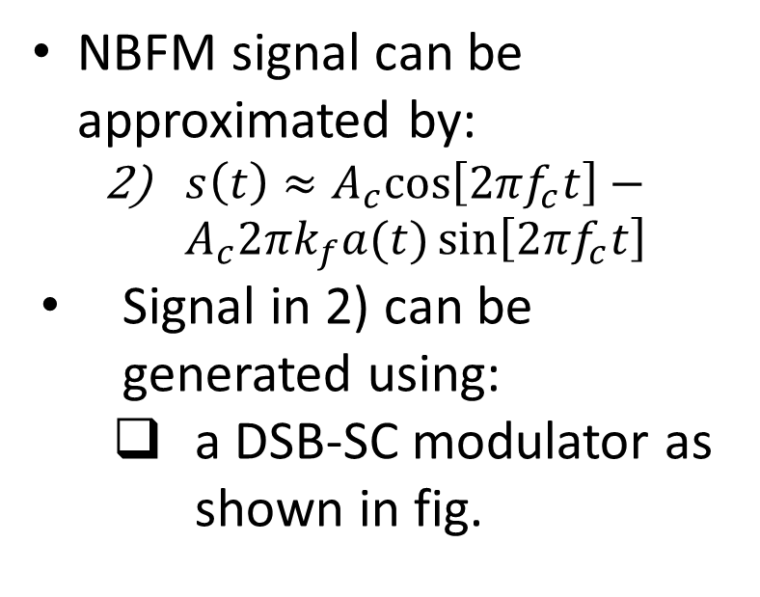
Narrow-band FM (NBFM) Generation
Recall: FM signal given by:
$s\left(t\right)=A_{c}cos\left[2πf_{c}t+2πk_{f}\int_{0}^{t}{m\left(τ\right)dτ}\right]$
Let $a\left(t\right)=\int_{0}^{t}{m\left(τ\right)dτ}$
Recall: when $\left|k_{f}a\left(t\right)\right|≪1$ for all $t$, the signal $s(t)$ called narrow-band FM signal
NBFM signal can be approximated by:
$s\left(t\right)≈A_{c}cos\left[2πf_{c}t\right]−A_{c}2πk_{f}a(t)\sin\left[2πf_{c}t\right]$
Signal in 2) can be generated using:
a DSB-SC modulator as shown in fig.
Ref: B.P. Lathi, Z. Ding, “Modern Digital and Analog Communication Systems”, 4th ed.

Slide 4
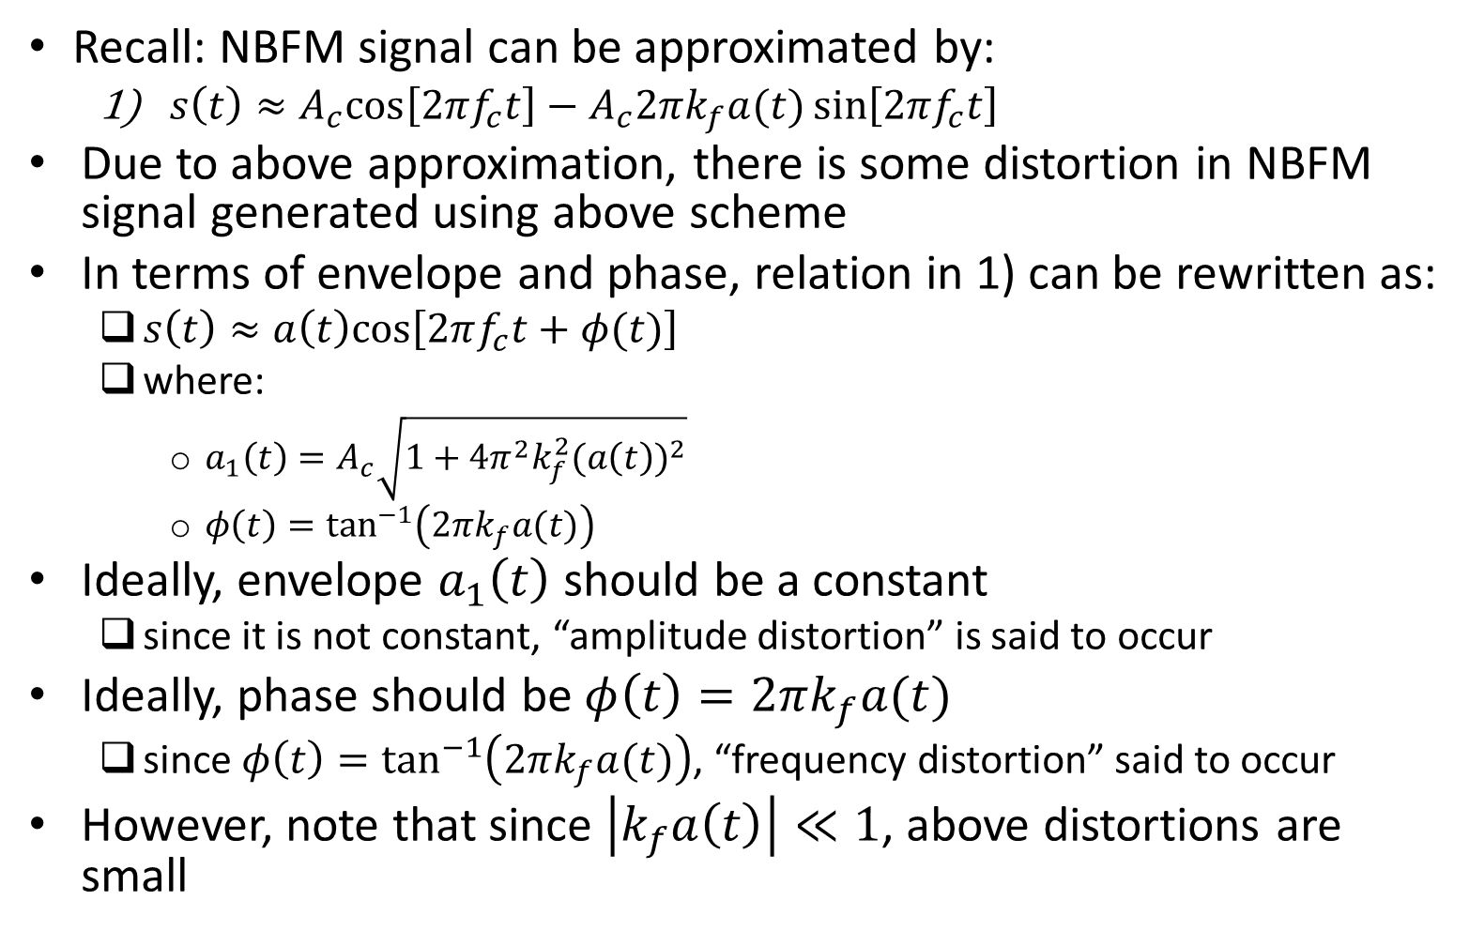
Distortion in NBFM Signal
Recall: NBFM signal can be approximated by:
$s\left(t\right)≈A_{c}cos\left[2πf_{c}t\right]−A_{c}2πk_{f}a(t)\sin\left[2πf_{c}t\right]$
Due to above approximation, there is some distortion in NBFM signal generated using above scheme
In terms of envelope and phase, relation in 1) can be rewritten as:
$s\left(t\right)≈a\left(t\right)cos⁡\left[2πf_{c}t+φ(t)\right]$
where:
$a_{1}\left(t\right)=A_{c}\sqrt{1+4π^{2}k_{f}^{2}{(a\left(t\right))}^{2}}$
$φ\left(t\right)=\tan^{−1}\left(2πk_{f}a(t)\right)$
Ideally, envelope $a_{1}\left(t\right)$ should be a constant
since it is not constant, “amplitude distortion” is said to occur
Ideally, phase should be $φ\left(t\right)=2πk_{f}a(t)$
since $φ\left(t\right)=\tan^{−1}\left(2πk_{f}a(t)\right)$, “frequency distortion” said to occur
However, note that since $\left|k_{f}a\left(t\right)\right|≪1$, above distortions are small

Slide 5
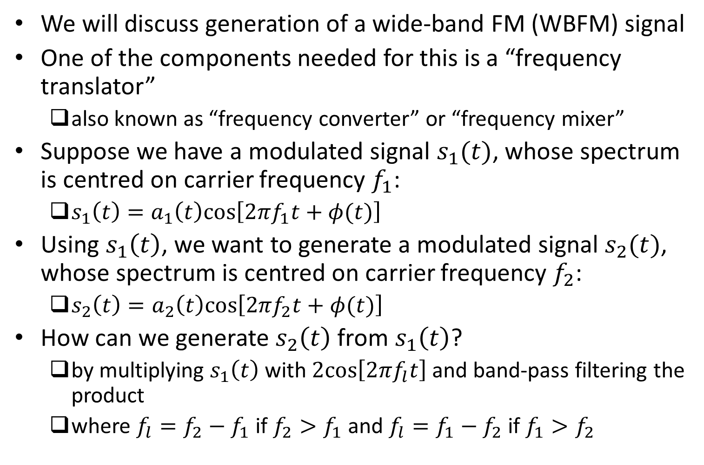
Frequency Translation
We will discuss generation of a wide-band FM (WBFM) signal
One of the components needed for this is a “frequency translator”
also known as “frequency converter” or “frequency mixer”
Suppose we have a modulated signal $s_{1}(t)$, whose spectrum is centred on carrier frequency $f_{1}$:
$s_{1}\left(t\right)=a_{1}\left(t\right)cos⁡\left[2πf_{1}t+φ(t)\right]$
Using $s_{1}\left(t\right)$, we want to generate a modulated signal $s_{2}(t)$, whose spectrum is centred on carrier frequency $f_{2}$:
$s_{2}\left(t\right)=a_{2}\left(t\right)cos⁡\left[2πf_{2}t+φ(t)\right]$
How can we generate $s_{2}\left(t\right)$ from $s_{1}\left(t\right)$?
by multiplying $s_{1}\left(t\right)$ with $2cos⁡\left[2πf_{l}t\right]$ and band-pass filtering the product
where $f_{l}=f_{2}−f_{1}$ if $f_{2}>f_{1}$ and $f_{l}=f_{1}−f_{2}$ if $f_{1}>f_{2}$

Slide 6
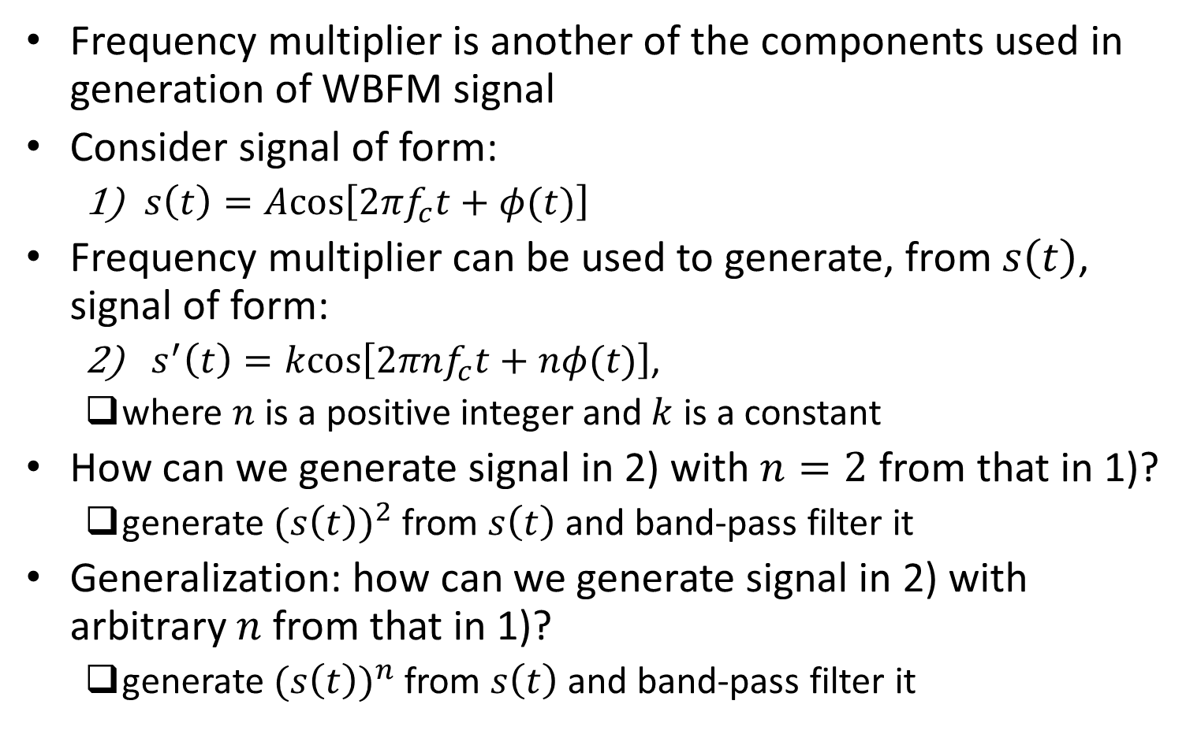
Frequency Multiplication
Frequency multiplier is another of the components used in generation of WBFM signal
Consider signal of form:
$s\left(t\right)=Acos⁡\left[2πf_{c}t+φ(t)\right]$
Frequency multiplier can be used to generate, from $s\left(t\right)$, signal of form:
$s^{′}\left(t\right)=kcos⁡\left[2πnf_{c}t+nφ(t)\right]$,
where $n$ is a positive integer and $k$ is a constant
How can we generate signal in 2) with $n=2$ from that in 1)?
generate ${(s\left(t\right))}^{2}$ from $s\left(t\right)$ and band-pass filter it
Generalization: how can we generate signal in 2) with arbitrary $n$ from that in 1)?
generate ${(s\left(t\right))}^{n}$ from $s\left(t\right)$ and band-pass filter it

Slide 7
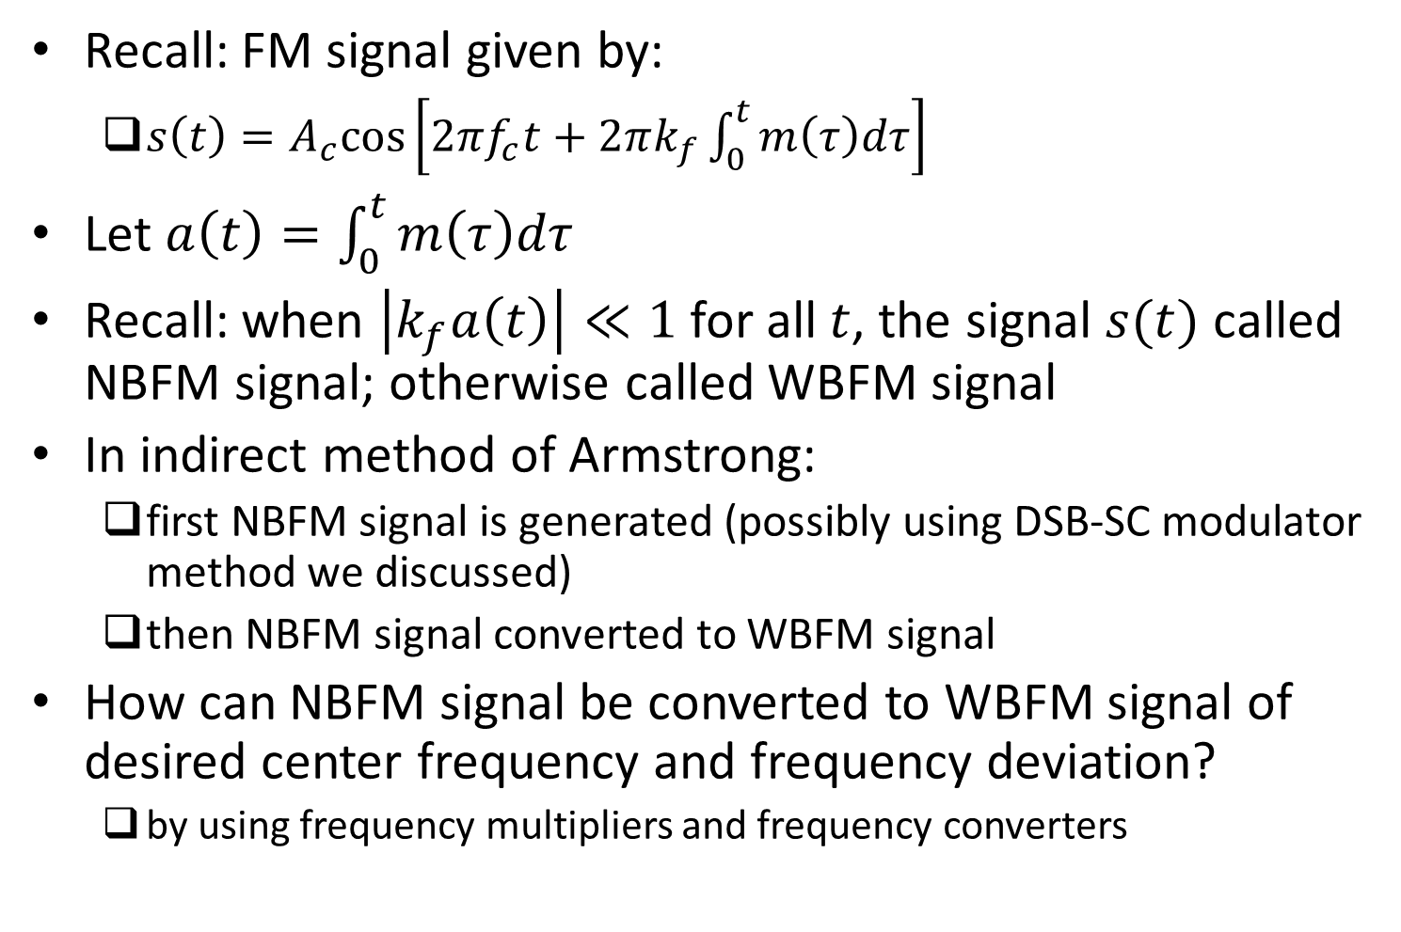
Indirect Method of Armstrong
Recall: FM signal given by:
$s\left(t\right)=A_{c}cos\left[2πf_{c}t+2πk_{f}\int_{0}^{t}{m\left(τ\right)dτ}\right]$
Let $a\left(t\right)=\int_{0}^{t}{m\left(τ\right)dτ}$
Recall: when $\left|k_{f}a\left(t\right)\right|≪1$ for all $t$, the signal $s(t)$ called NBFM signal; otherwise called WBFM signal
In indirect method of Armstrong:
first NBFM signal is generated (possibly using DSB-SC modulator method we discussed)
then NBFM signal converted to WBFM signal
How can NBFM signal be converted to WBFM signal of desired center frequency and frequency deviation?
by using frequency multipliers and frequency converters

Slide 8
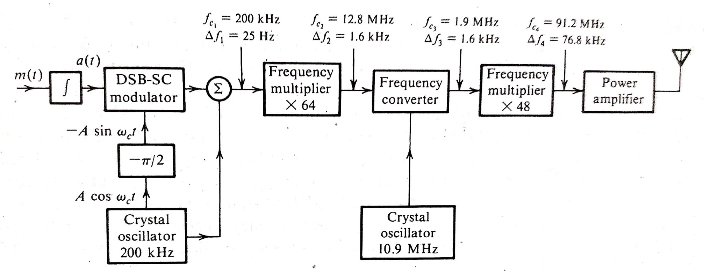
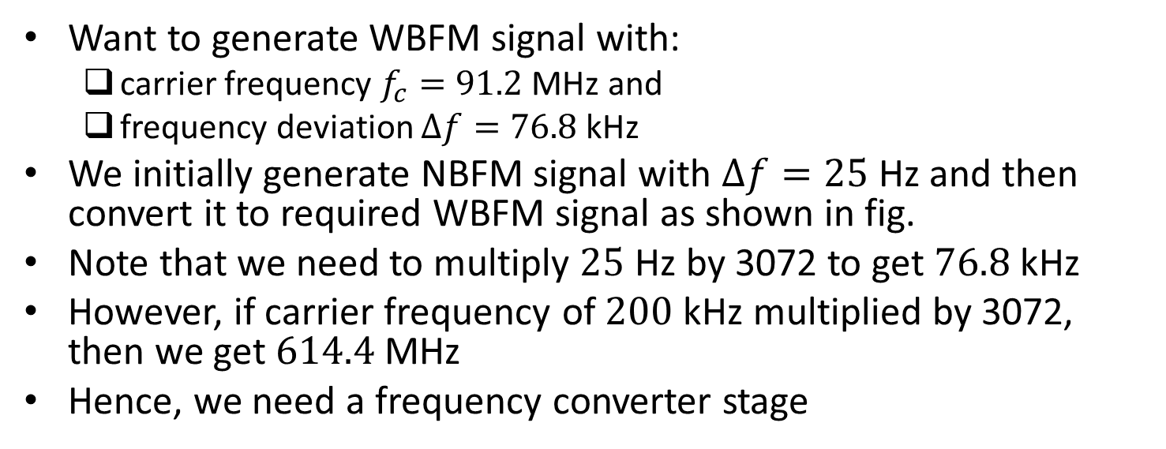
Example
Want to generate WBFM signal with:
carrier frequency $f_{c}=91.2$ MHz and
frequency deviation $∆f=76.8$ kHz
We initially generate NBFM signal with $∆f=25$ Hz and then convert it to required WBFM signal as shown in fig.
Note that we need to multiply $25$ Hz by 3072 to get $76.8$ kHz
However, if carrier frequency of $200$ kHz multiplied by 3072, then we get $614.4$ MHz
Hence, we need a frequency converter stage
Ref: B.P. Lathi, Z. Ding, “Modern Digital and Analog Communication Systems”, 4th ed.

Slide 9
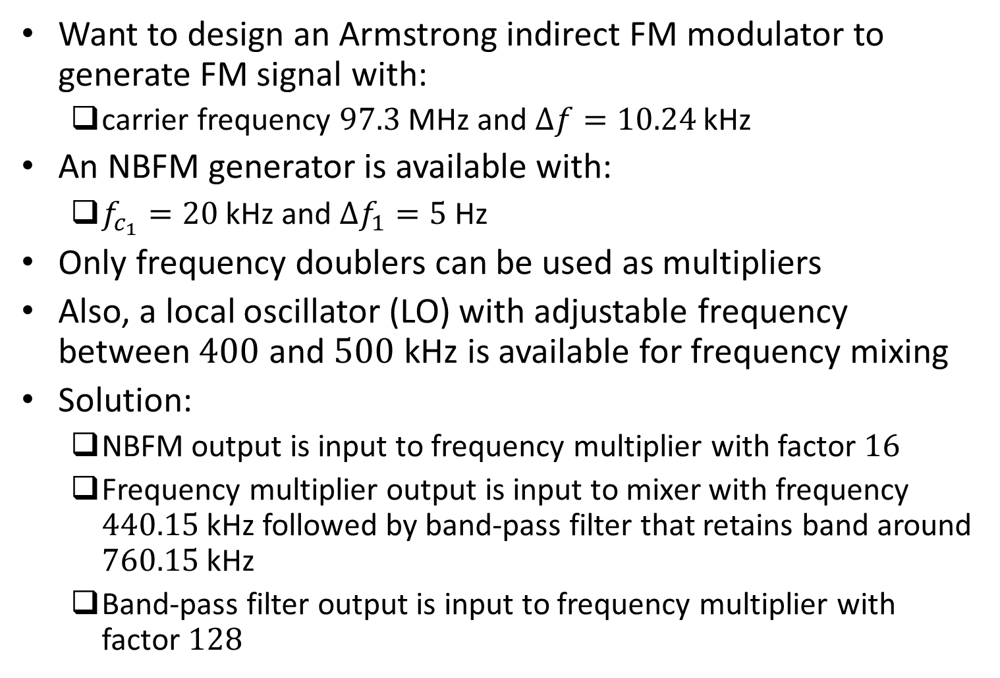
Example
Want to design an Armstrong indirect FM modulator to generate FM signal with:
carrier frequency $97.3$ MHz and $∆f=10.24$ kHz
An NBFM generator is available with:
$f_{c_{1}}=20$ kHz and $∆f_{1}=5$ Hz
Only frequency doublers can be used as multipliers
Also, a local oscillator (LO) with adjustable frequency between $400$ and $500$ kHz is available for frequency mixing
Solution:
NBFM output is input to frequency multiplier with factor $16$
Frequency multiplier output is input to mixer with frequency $440.15$ kHz followed by band-pass filter that retains band around $760.15$ kHz
Band-pass filter output is input to frequency multiplier with factor $128$

Slide 10
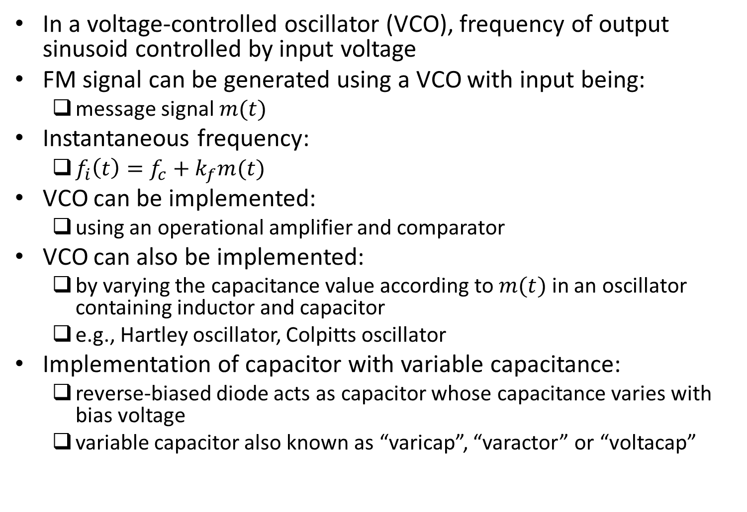
Direct Generation of Wideband FM Signals
In a voltage-controlled oscillator (VCO), frequency of output sinusoid controlled by input voltage
FM signal can be generated using a VCO with input being:
message signal $m(t)$
Instantaneous frequency:
$f_{i}\left(t\right)=f_{c}+k_{f}m(t)$
VCO can be implemented:
using an operational amplifier and comparator
VCO can also be implemented:
by varying the capacitance value according to $m(t)$ in an oscillator containing inductor and capacitor
e.g., Hartley oscillator, Colpitts oscillator
Implementation of capacitor with variable capacitance:
reverse-biased diode acts as capacitor whose capacitance varies with bias voltage
variable capacitor also known as “varicap”, “varactor” or “voltacap”

Slide 11
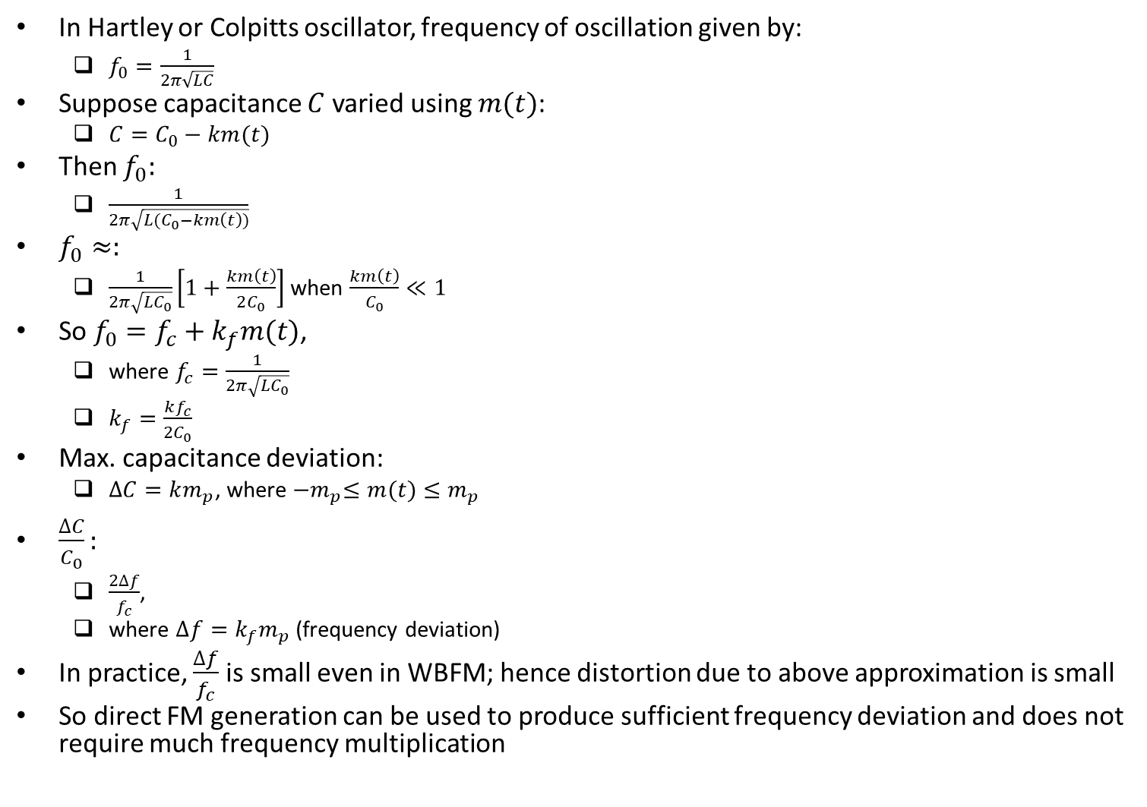
Direct Generation of Wideband FM Signals (contd.)
In Hartley or Colpitts oscillator, frequency of oscillation given by:
$f_{0}=\frac{1}{2π\sqrt{LC}}$
Suppose capacitance $C$ varied using $m(t)$:
$C=C_{0}−km(t)$
Then $f_{0}:$
$\frac{1}{2π\sqrt{L(C_{0}−km\left(t\right))}}$
$f_{0}≈:$
$\frac{1}{2π\sqrt{LC_{0}}}\left[1+\frac{km\left(t\right)}{2C_{0}}\right]$ when $\frac{km\left(t\right)}{C_{0}}≪1$
So $f_{0}=f_{c}+k_{f}m(t)$,
where $f_{c}=\frac{1}{2π\sqrt{LC_{0}}}$
$k_{f}=\frac{kf_{c}}{2C_{0}}$
Max. capacitance deviation:
$∆C=km_{p}$, where ${−m}_{p}≤m(t)≤m_{p}$
$\frac{∆C}{C_{0}}:$
$\frac{2∆f}{f_{c}}$,
where $∆f=k_{f}m_{p}$ (frequency deviation)
In practice, $\frac{∆f}{f_{c}}$ is small even in WBFM; hence distortion due to above approximation is small
So direct FM generation can be used to produce sufficient frequency deviation and does not require much frequency multiplication

Slide 12
Demodulation of FM Signals

Slide 13
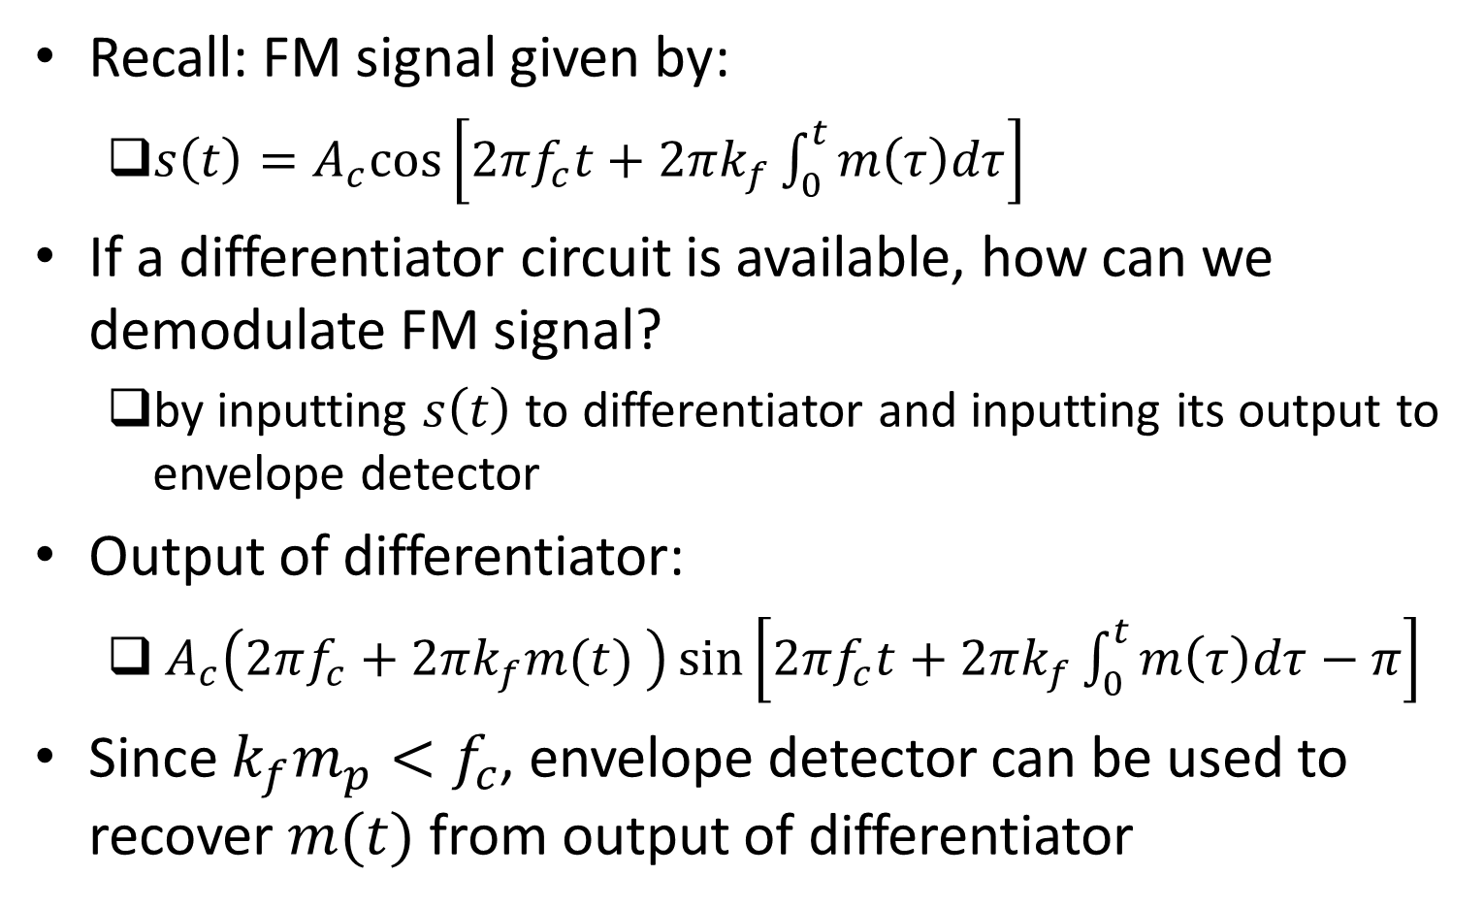
Demodulation Using Differentiator
Recall: FM signal given by:
$s\left(t\right)=A_{c}cos\left[2πf_{c}t+2πk_{f}\int_{0}^{t}{m\left(τ\right)dτ}\right]$
If a differentiator circuit is available, how can we demodulate FM signal?
by inputting $s\left(t\right)$ to differentiator and inputting its output to envelope detector
Output of differentiator:
$A_{c}\left(2πf_{c}+2πk_{f}m(t) \right)\sin\left[2πf_{c}t+2πk_{f}\int_{0}^{t}{m\left(τ\right)dτ}−π\right]$
Since $k_{f}m_{p}<f_{c}$, envelope detector can be used to recover $m(t)$ from output of differentiator

Slide 14
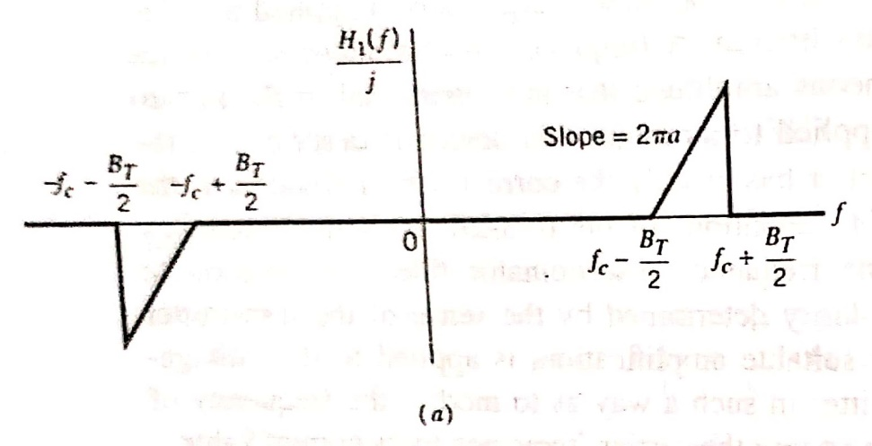
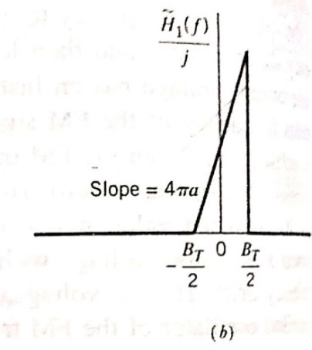
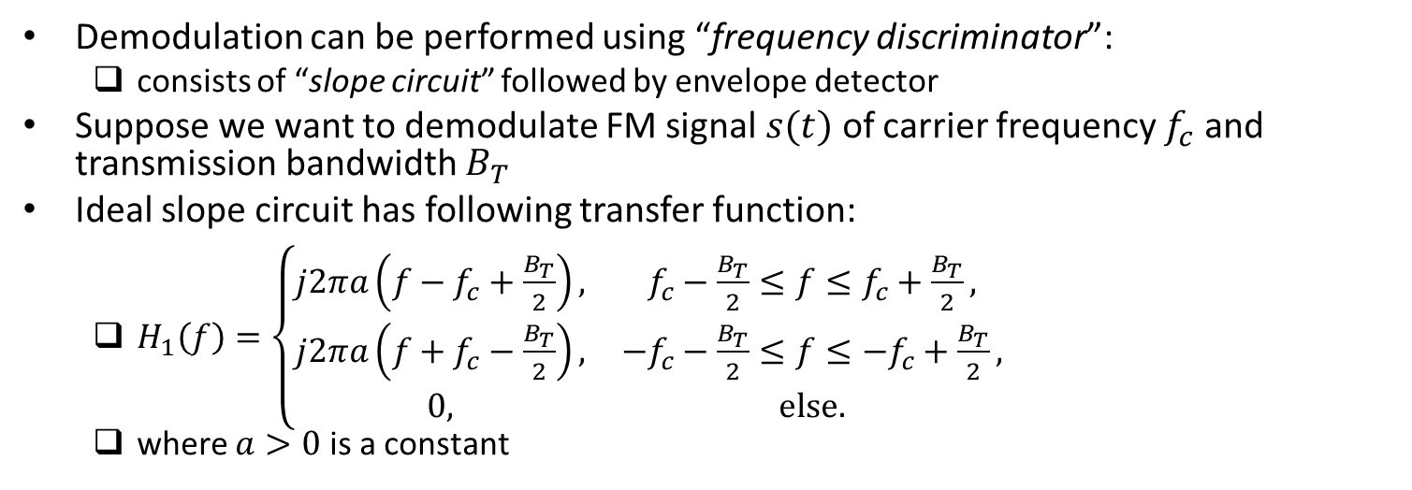
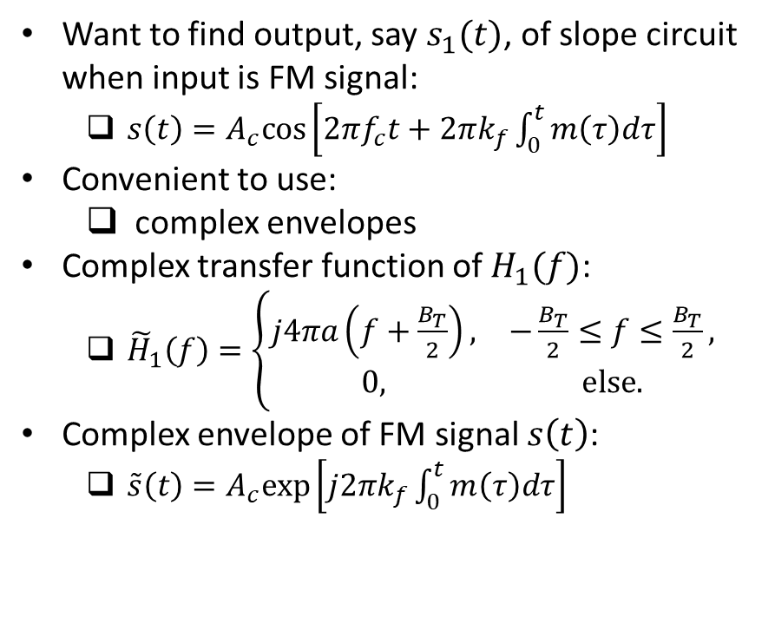
Demodulation Using Slope Circuit
Demodulation can be performed using “frequency discriminator”:
consists of “slope circuit” followed by envelope detector
Suppose we want to demodulate FM signal $s(t)$ of carrier frequency $f_{c}$ and transmission bandwidth $B_{T}$
Ideal slope circuit has following transfer function:
$H_{1}\left(f\right)=\left\{\begin{matrix}j2πa\left(f−f_{c}+\frac{B_{T}}{2}\right), & f_{c}−\frac{B_{T}}{2}≤f≤f_{c}+\frac{B_{T}}{2}, \\ j2πa\left(f+f_{c}−\frac{B_{T}}{2}\right), & {−f}_{c}−\frac{B_{T}}{2}≤f≤{−f}_{c}+\frac{B_{T}}{2}, \\ 0, & else.\end{matrix}\right.$
where $a>0$ is a constant
Want to find output, say $s_{1}(t)$, of slope circuit when input is FM signal:
$s\left(t\right)=A_{c}cos\left[2πf_{c}t+2πk_{f}\int_{0}^{t}{m\left(τ\right)dτ}\right]$
Convenient to use:
complex envelopes
Complex transfer function of $H_{1}(f)$:
${\tilde{H}}_{1}\left(f\right)=\left\{\begin{matrix}j4πa\left(f+\frac{B_{T}}{2}\right), & −\frac{B_{T}}{2}≤f≤\frac{B_{T}}{2}, \\ 0, & else.\end{matrix}\right.$
Complex envelope of FM signal $s\left(t\right)$:
$\tilde{s}\left(t\right)=A_{c}exp\left[j2πk_{f}\int_{0}^{t}{m\left(τ\right)dτ}\right]$
Ref: “Communication Systems” by S. Haykin and M. Moher, 5th ed

Slide 15
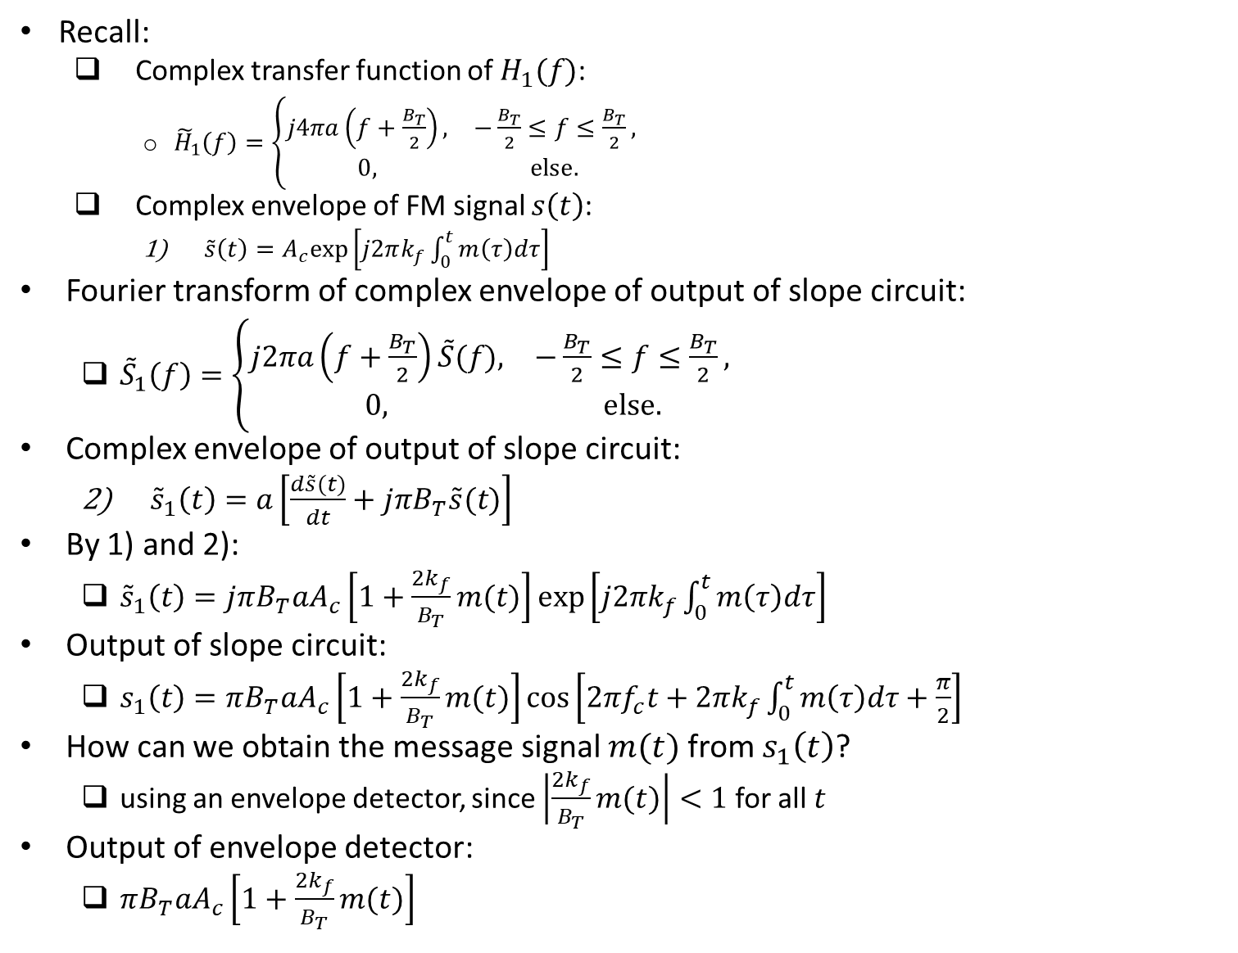
Demodulation Using Slope Circuit (contd.)
Recall:
Complex transfer function of $H_{1}(f)$:
${\tilde{H}}_{1}\left(f\right)=\left\{\begin{matrix}j4πa\left(f+\frac{B_{T}}{2}\right), & −\frac{B_{T}}{2}≤f≤\frac{B_{T}}{2}, \\ 0, & else.\end{matrix}\right.$
Complex envelope of FM signal $s\left(t\right)$:
$\tilde{s}\left(t\right)=A_{c}exp\left[j2πk_{f}\int_{0}^{t}{m\left(τ\right)dτ}\right]$
Fourier transform of complex envelope of output of slope circuit:
${\tilde{S}}_{1}\left(f\right)=\left\{\begin{matrix}j2πa\left(f+\frac{B_{T}}{2}\right)\tilde{S}(f), & −\frac{B_{T}}{2}≤f≤\frac{B_{T}}{2}, \\ 0, & else.\end{matrix}\right.$
Complex envelope of output of slope circuit:
${\tilde{s}}_{1}\left(t\right)=a\left[\frac{d\tilde{s}(t)}{dt}+jπB_{T}\tilde{s}(t)\right]$
By 1) and 2):
${\tilde{s}}_{1}\left(t\right)=jπB_{T}aA_{c}\left[1+\frac{2k_{f}}{B_{T}}m(t)\right]exp\left[j2πk_{f}\int_{0}^{t}{m\left(τ\right)dτ}\right]$
Output of slope circuit:
$s_{1}\left(t\right)=πB_{T}aA_{c}\left[1+\frac{2k_{f}}{B_{T}}m(t)\right]\cos\left[2πf_{c}t+2πk_{f}\int_{0}^{t}{m\left(τ\right)dτ}+\frac{π}{2}\right]$
How can we obtain the message signal $m(t)$ from $s_{1}\left(t\right)$?
using an envelope detector, since $\left|\frac{2k_{f}}{B_{T}}m(t)\right|<1$ for all $t$
Output of envelope detector:
$πB_{T}aA_{c}\left[1+\frac{2k_{f}}{B_{T}}m(t)\right]$

Slide 16
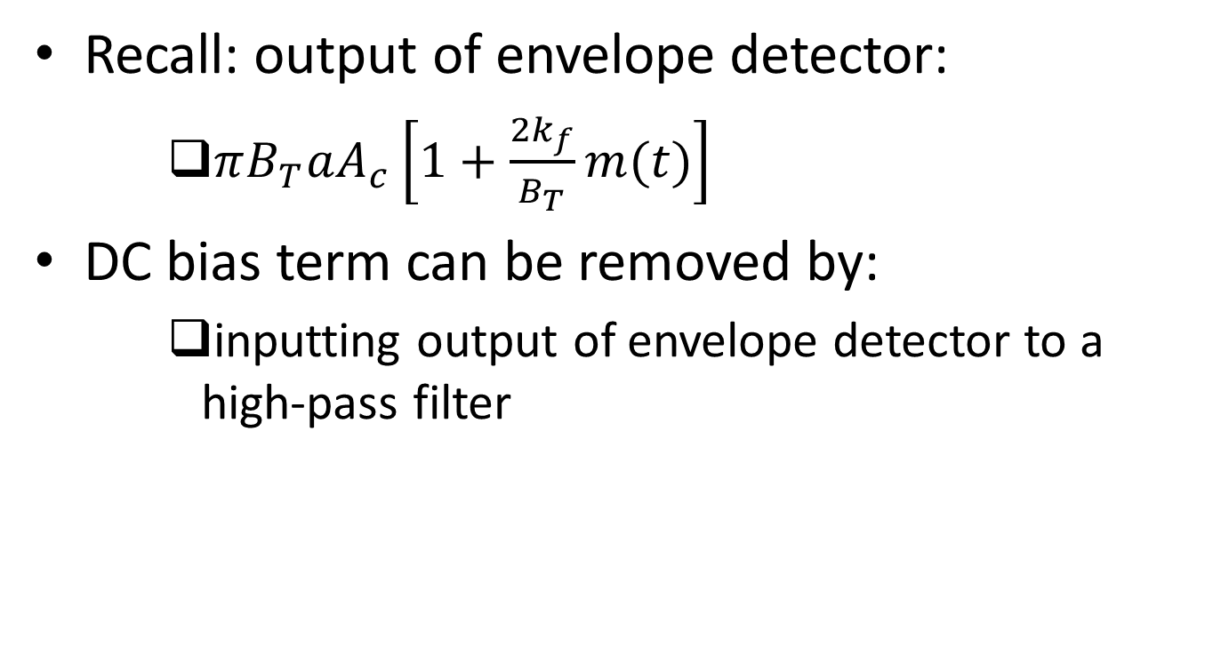
Demodulation Using Slope Circuit (contd.)
Recall: output of envelope detector:
$πB_{T}aA_{c}\left[1+\frac{2k_{f}}{B_{T}}m(t)\right]$
DC bias term can be removed by:
inputting output of envelope detector to a high-pass filter

Slide 17
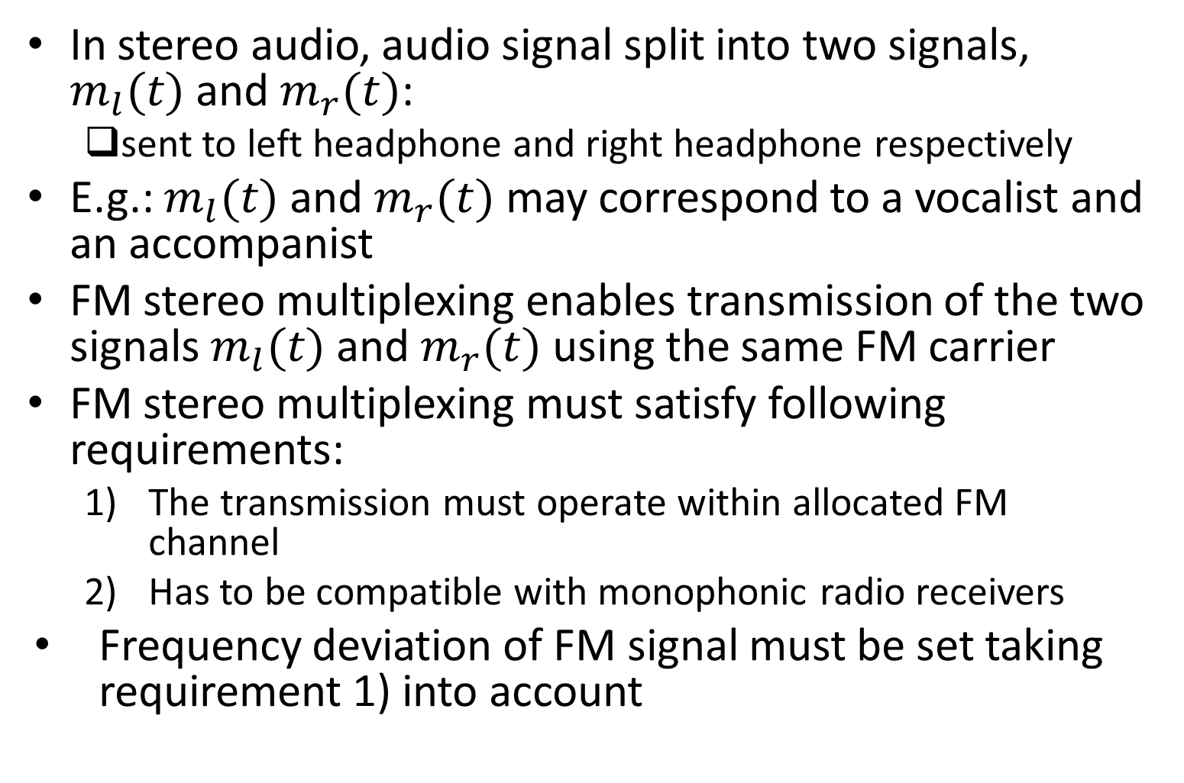
FM Stereo Multiplexing
In stereo audio, audio signal split into two signals, $m_{l}(t)$ and $m_{r}(t)$:
sent to left headphone and right headphone respectively
E.g.: $m_{l}(t)$ and $m_{r}(t)$ may correspond to a vocalist and an accompanist
FM stereo multiplexing enables transmission of the two signals $m_{l}(t)$ and $m_{r}(t)$ using the same FM carrier
FM stereo multiplexing must satisfy following requirements:
The transmission must operate within allocated FM channel
Has to be compatible with monophonic radio receivers
Frequency deviation of FM signal must be set taking requirement 1) into account

Slide 18
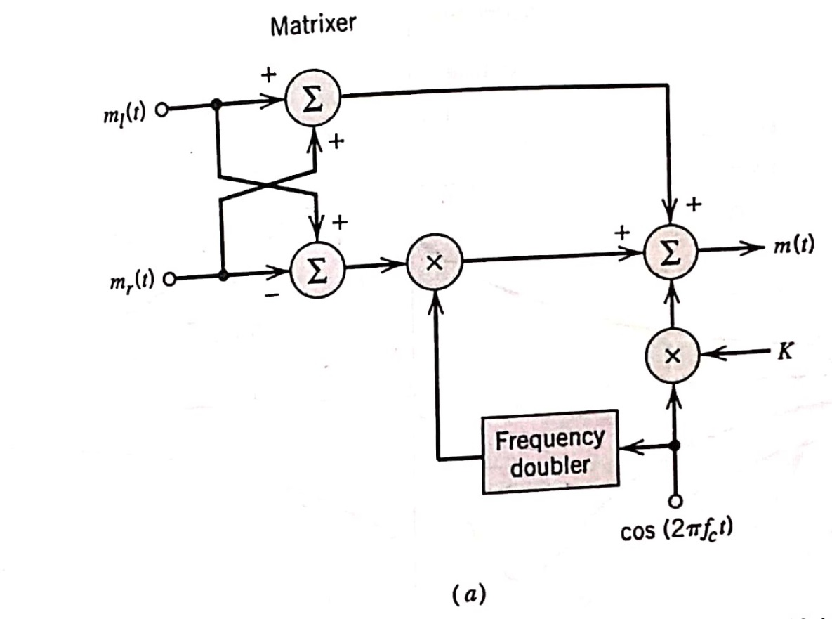
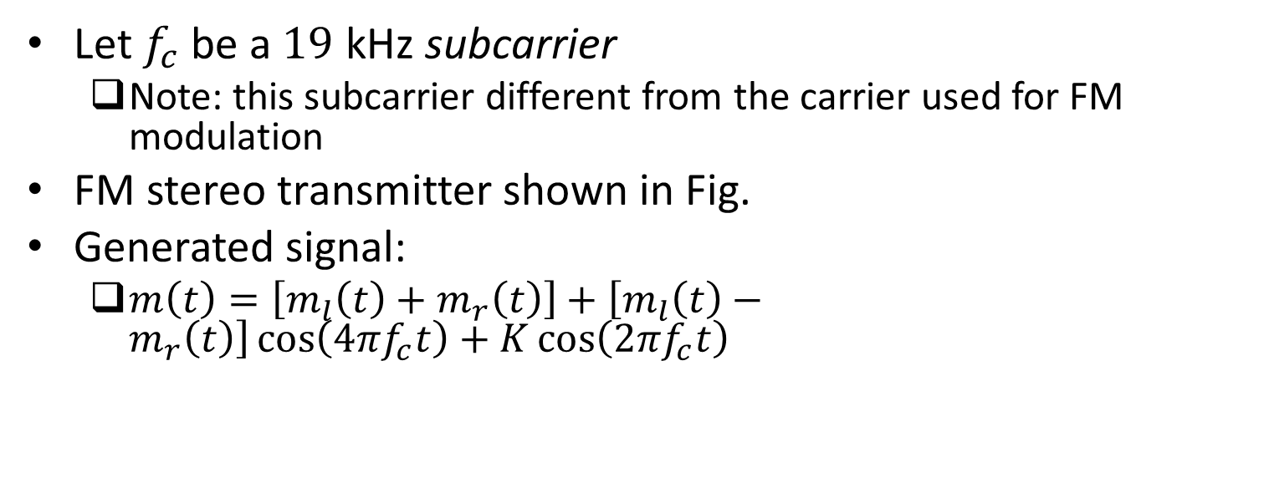
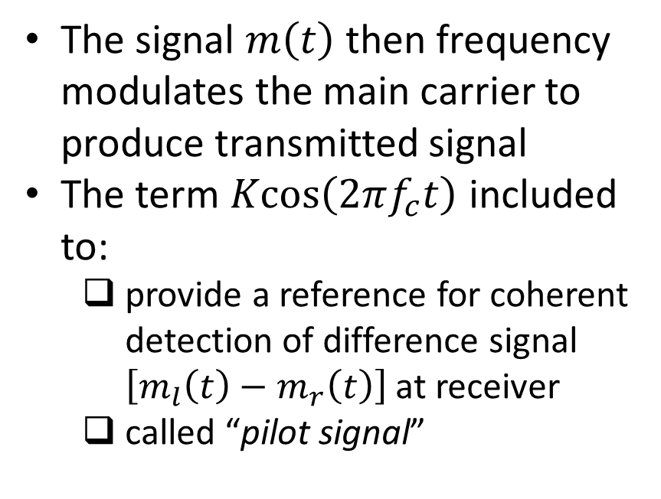
FM Stereo Multiplexing (contd.)
Let $f_{c}$ be a $19$ kHz subcarrier
Note: this subcarrier different from the carrier used for FM modulation
FM stereo transmitter shown in Fig.
Generated signal:
$m\left(t\right)=\left[m_{l}\left(t\right)+m_{r}\left(t\right)\right]+\left[m_{l}\left(t\right)−m_{r}\left(t\right)\right]\cos\left(4πf_{c}t\right)+K\cos\left(2πf_{c}t\right)$
The signal $m\left(t\right)$ then frequency modulates the main carrier to produce transmitted signal
The term $\operatorname{Kcos}\left(2πf_{c}t\right)$ included to:
provide a reference for coherent detection of difference signal $\left[m_{l}\left(t\right)−m_{r}\left(t\right)\right]$ at receiver
called “pilot signal”
Ref: “Communication Systems” by S. Haykin and M. Moher, 5th ed

Slide 19
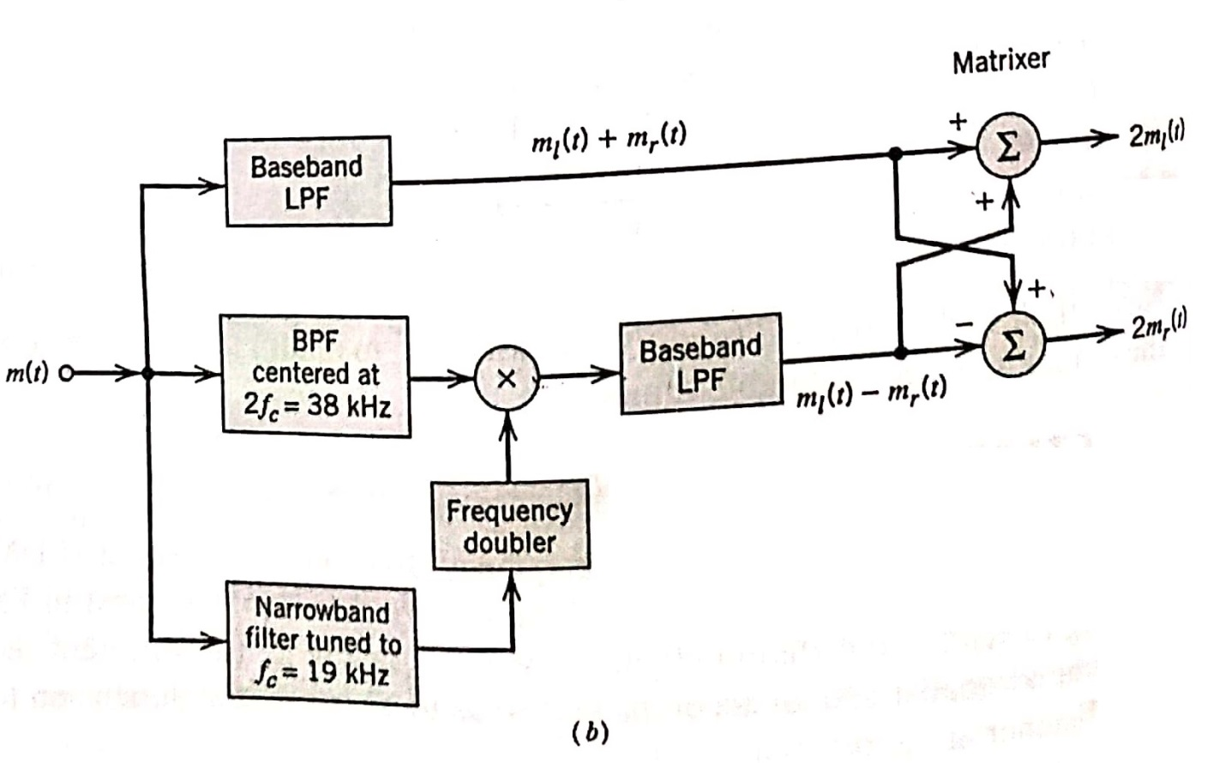
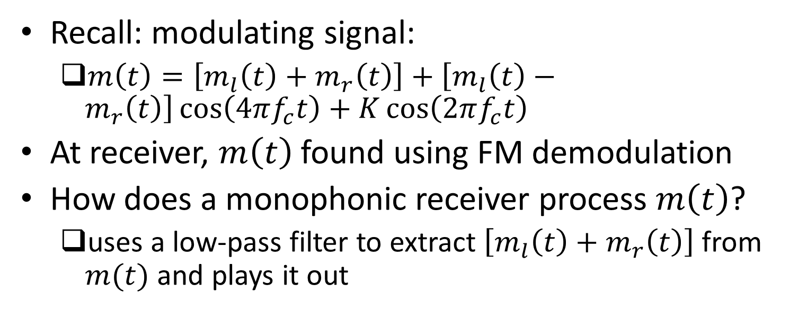
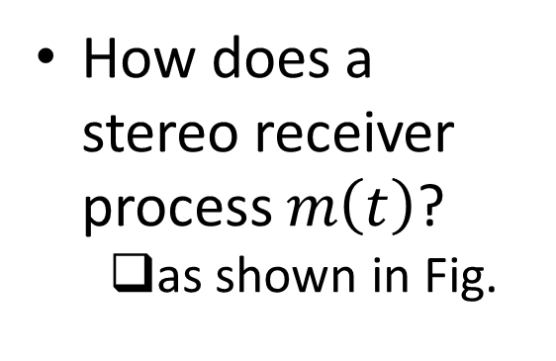
FM Stereo Multiplexing (contd.)
Recall: modulating signal:
$m\left(t\right)=\left[m_{l}\left(t\right)+m_{r}\left(t\right)\right]+\left[m_{l}\left(t\right)−m_{r}\left(t\right)\right]\cos\left(4πf_{c}t\right)+K\cos\left(2πf_{c}t\right)$
At receiver, $m\left(t\right)$ found using FM demodulation
How does a monophonic receiver process $m\left(t\right)$?
uses a low-pass filter to extract $\left[m_{l}\left(t\right)+m_{r}\left(t\right)\right]$ from $m(t)$ and plays it out
How does a stereo receiver process $m\left(t\right)$?
as shown in Fig.
Ref: “Communication Systems” by S. Haykin and M. Moher, 5th ed

Slide 20
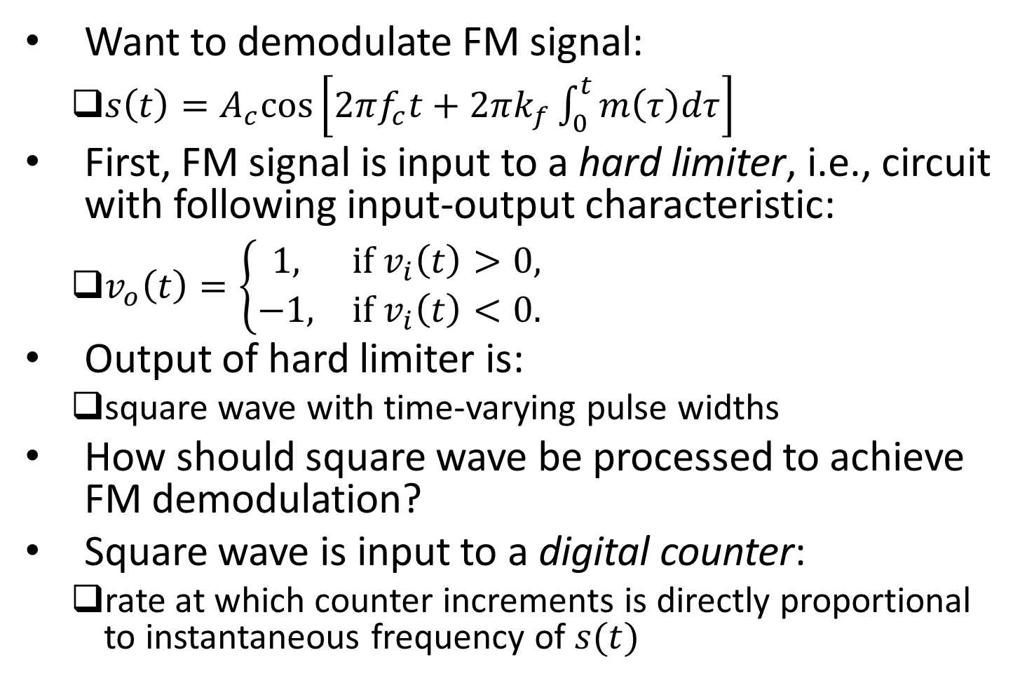
Zero-Crossing Detectors
Want to demodulate FM signal:
$s\left(t\right)=A_{c}cos\left[2πf_{c}t+2πk_{f}\int_{0}^{t}{m\left(τ\right)dτ}\right]$
First, FM signal is input to a hard limiter, i.e., circuit with following input-output characteristic:
$v_{o}\left(t\right)=\left\{\begin{matrix}1, & if v_{i}\left(t\right)>0, \\ −1, & if{ v}_{i}\left(t\right)<0.\end{matrix}\right.$
Output of hard limiter is:
square wave with time-varying pulse widths
How should square wave be processed to achieve FM demodulation?
Square wave is input to a digital counter:
rate at which counter increments is directly proportional to instantaneous frequency of $s(t)$

Slide 21
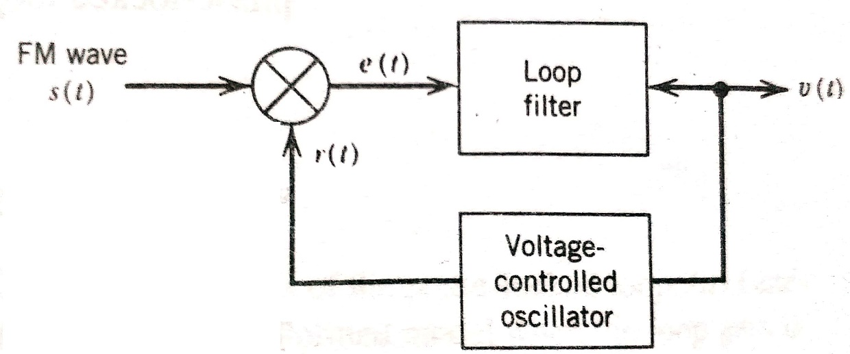
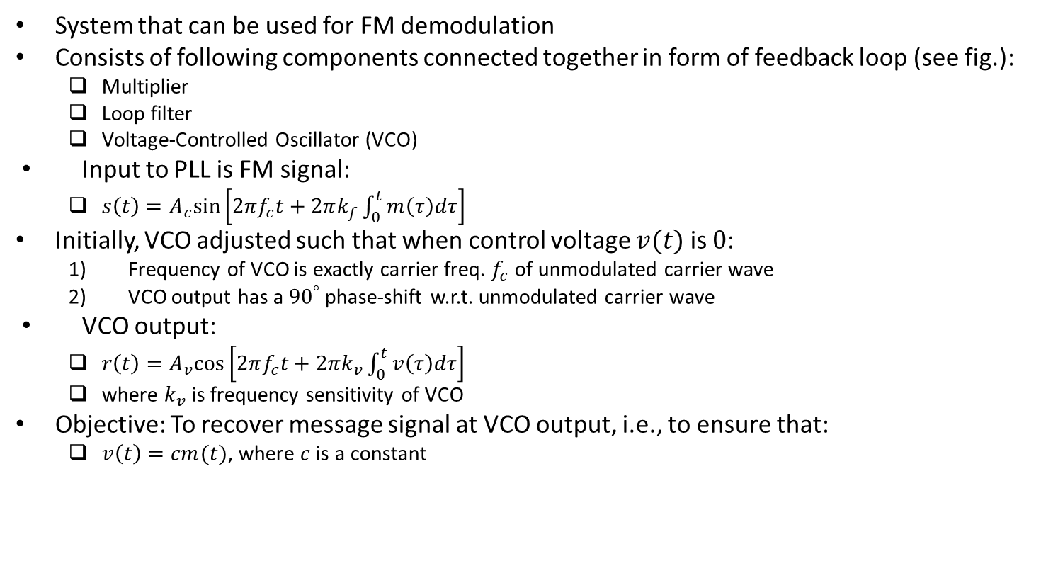
Phase-Locked Loop (PLL)
System that can be used for FM demodulation
Consists of following components connected together in form of feedback loop (see fig.):
Multiplier
Loop filter
Voltage-Controlled Oscillator (VCO)
Input to PLL is FM signal:
$s\left(t\right)=A_{c}sin\left[2πf_{c}t+2πk_{f}\int_{0}^{t}{m\left(τ\right)dτ}\right]$
Initially, VCO adjusted such that when control voltage $v(t)$ is $0$:
Frequency of VCO is exactly carrier freq. $f_{c}$ of unmodulated carrier wave
VCO output has a ${90}^{°}$ phase-shift w.r.t. unmodulated carrier wave
VCO output:
$r\left(t\right)=A_{v}cos\left[2πf_{c}t+2πk_{v}\int_{0}^{t}{v\left(τ\right)dτ}\right]$
where $k_{v}$ is frequency sensitivity of VCO
Objective: To recover message signal at VCO output, i.e., to ensure that:
$v\left(t\right)=cm(t)$, where $c$ is a constant
Ref: “Communication Systems” by S. Haykin and M. Moher, 5th ed

Slide 22
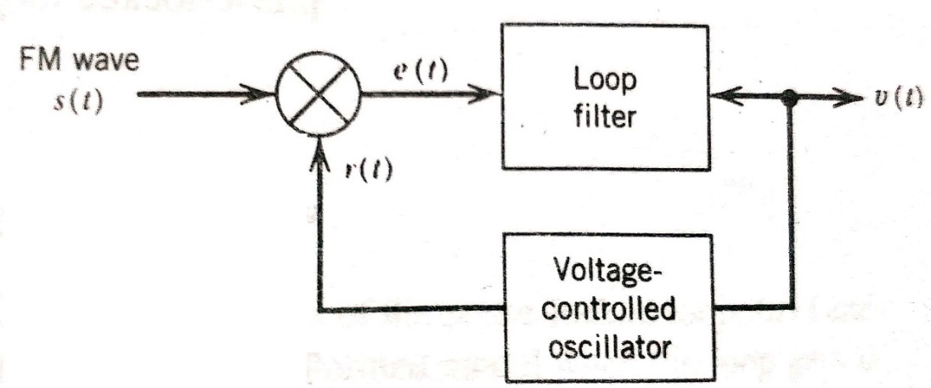
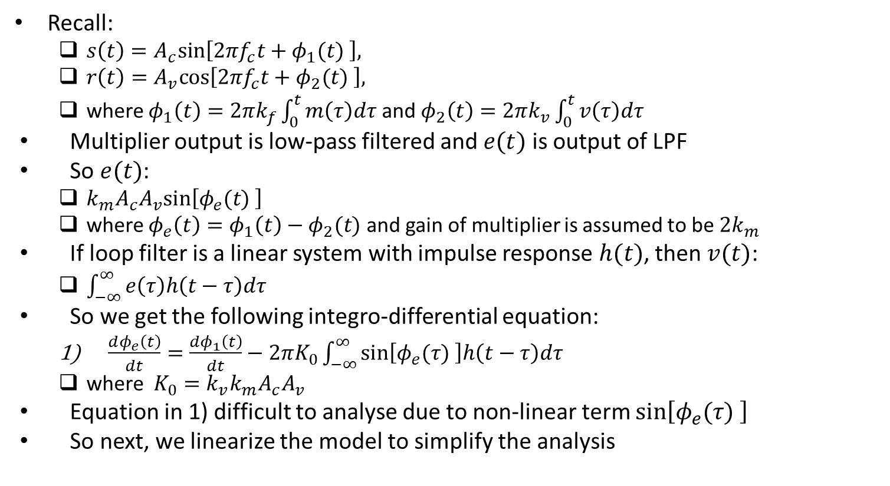
Non-Linear Model of PLL
Recall:
$s\left(t\right)=A_{c}sin\left[2πf_{c}t+φ_{1}(t) \right],$
$r\left(t\right)=A_{v}cos\left[2πf_{c}t+φ_{2}(t) \right],$
where $φ_{1}\left(t\right)=2πk_{f}\int_{0}^{t}{m\left(τ\right)dτ}$ and $φ_{2}\left(t\right)=2πk_{v}\int_{0}^{t}{v\left(τ\right)dτ}$
Multiplier output is low-pass filtered and $e(t)$ is output of LPF
So $e(t)$:
$k_{m}A_{c}A_{v}sin\left[φ_{e}(t) \right]$
where $φ_{e}\left(t\right)=φ_{1}\left(t\right)−φ_{2}(t)$ and gain of multiplier is assumed to be ${2k}_{m}$
If loop filter is a linear system with impulse response $h(t)$, then $v(t)$:
$\int_{−∞}^{∞}{e\left(τ\right)h\left(t−τ\right)dτ}$
So we get the following integro-differential equation:
$\frac{dφ_{e}\left(t\right)}{dt}=\frac{dφ_{1}\left(t\right)}{dt}−2πK_{0}\int_{−∞}^{∞}{sin\left[φ_{e}(τ) \right]h\left(t−τ\right)dτ}$
where $K_{0}=k_{v}k_{m}A_{c}A_{v}$
Equation in 1) difficult to analyse due to non-linear term $sin\left[φ_{e}(τ) \right]$
So next, we linearize the model to simplify the analysis
Ref: “Communication Systems” by S. Haykin and M. Moher, 5th ed

Slide 23
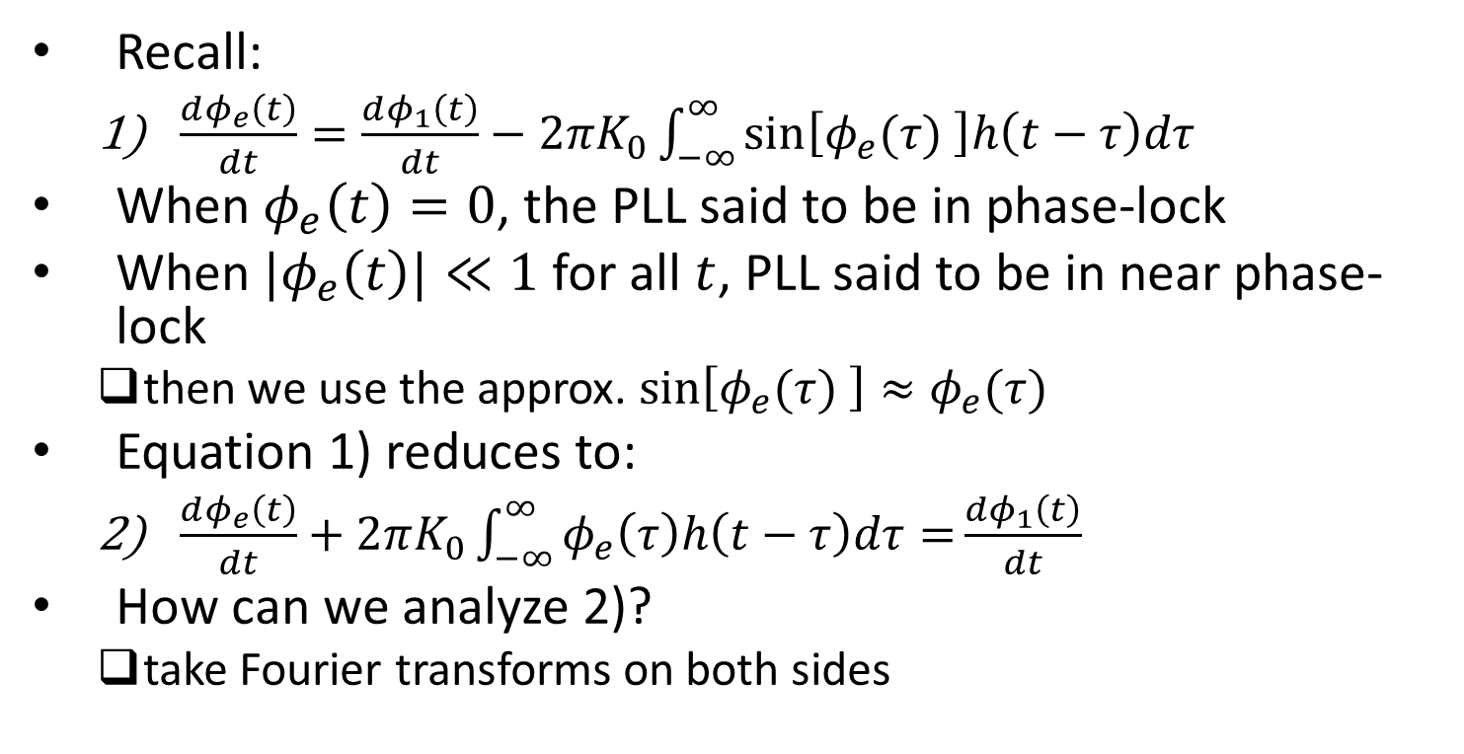
Linear Model of PLL
Recall:
$\frac{dφ_{e}\left(t\right)}{dt}=\frac{dφ_{1}\left(t\right)}{dt}−2πK_{0}\int_{−∞}^{∞}{sin\left[φ_{e}(τ) \right]h\left(t−τ\right)dτ}$
When $φ_{e}\left(t\right)=0$, the PLL said to be in phase-lock
When ${|φ}_{e}\left(t\right)|≪1$ for all $t$, PLL said to be in near phase-lock
then we use the approx. $sin\left[φ_{e}(τ) \right]≈φ_{e}(τ)$
Equation 1) reduces to:
$\frac{dφ_{e}\left(t\right)}{dt}+2πK_{0}\int_{−∞}^{∞}{φ_{e}\left(τ\right)h\left(t−τ\right)dτ=}\frac{dφ_{1}\left(t\right)}{dt}$
How can we analyze 2)?
take Fourier transforms on both sides
Ref: “Communication Systems” by S. Haykin and M. Moher, 5th ed

Slide 24
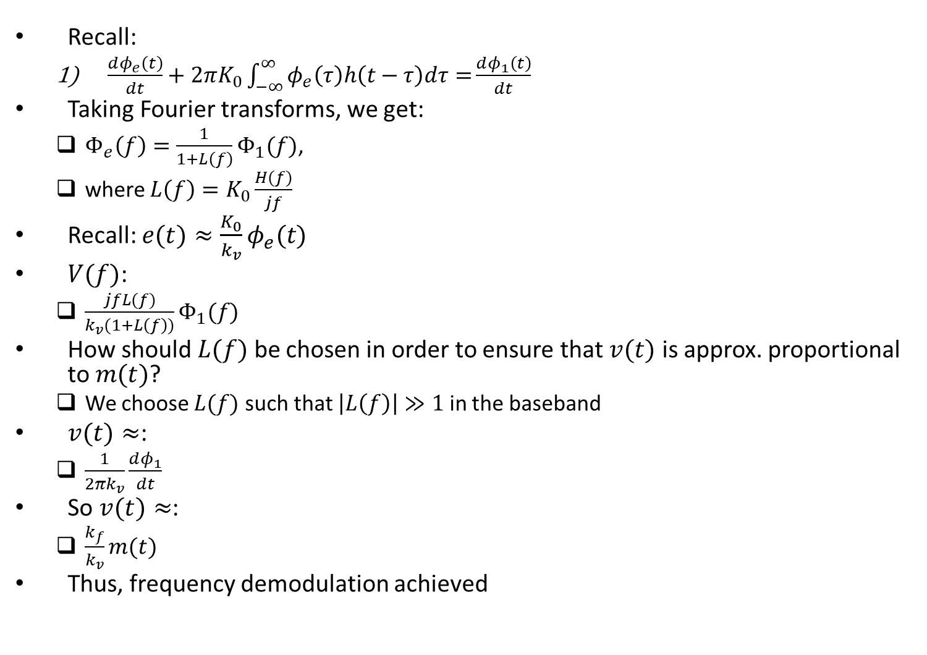
Linear Model of PLL (contd.)
Recall:
$\frac{dφ_{e}\left(t\right)}{dt}+2πK_{0}\int_{−∞}^{∞}{φ_{e}\left(τ\right)h\left(t−τ\right)dτ=}\frac{dφ_{1}\left(t\right)}{dt}$
Taking Fourier transforms, we get:
$Φ_{e}\left(f\right)=\frac{1}{1+L\left(f\right)}Φ_{1}(f)$,
where $L\left(f\right)=K_{0}\frac{H(f)}{jf}$
Recall: $e(t)≈\frac{K_{0}}{k_{v}}φ_{e}(t)$
$V(f)$:
$\frac{jfL(f)}{k_{v}(1+L\left(f\right))}Φ_{1}(f)$
How should $L(f)$ be chosen in order to ensure that $v(t)$ is approx. proportional to $m(t)$?
We choose $L(f)$ such that $\left|L\left(f\right)\right|≫1$ in the baseband
$v(t)≈$:
$\frac{1}{2πk_{v}}\frac{dφ_{1}}{dt}$
So $v(t)≈$:
$\frac{k_{f}}{k_{v}}m(t)$
Thus, frequency demodulation achieved
Ref: “Communication Systems” by S. Haykin and M. Moher, 5th ed

Slide 25
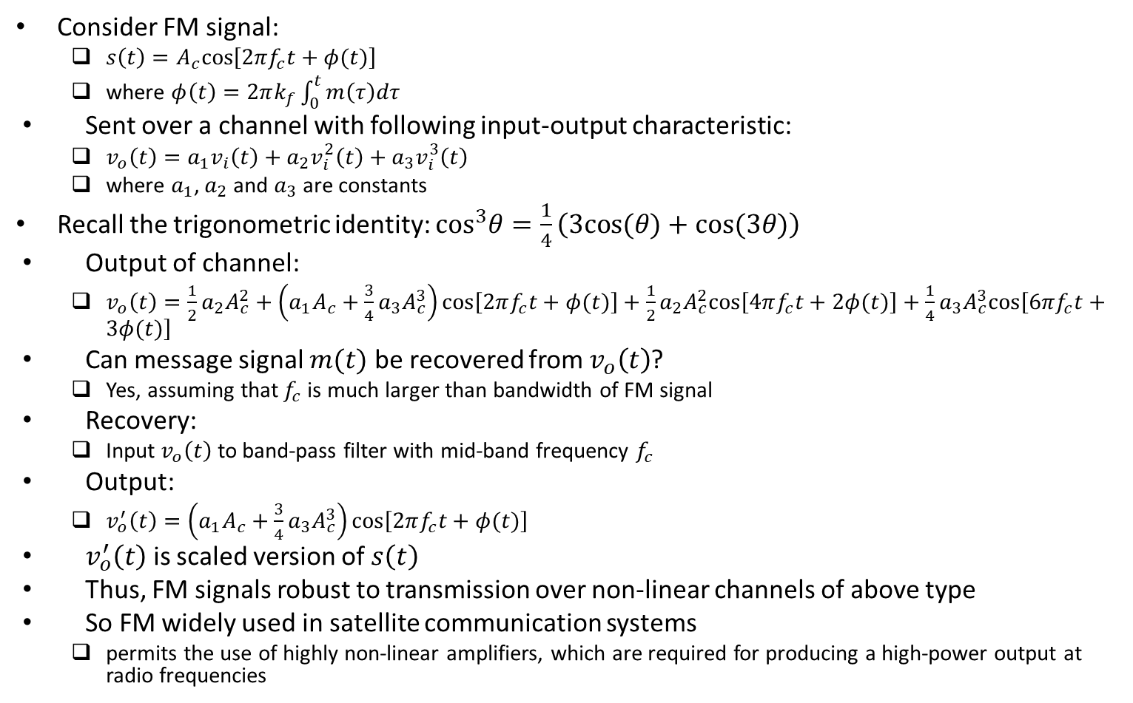
Effect of Sending FM Signal over Non-linear Channel
Consider FM signal:
$s\left(t\right)=A_{c}cos\left[2πf_{c}t+φ(t)\right]$
where $φ\left(t\right)=2πk_{f}\int_{0}^{t}{m\left(τ\right)dτ}$
Sent over a channel with following input-output characteristic:
$v_{o}\left(t\right)=a_{1}v_{i}\left(t\right)+a_{2}v_{i}^{2}\left(t\right)+a_{3}v_{i}^{3}\left(t\right)$
where $a_{1}$, $a_{2}$ and $a_{3}$ are constants
Recall the trigonometric identity: $\cos^{3}θ=\frac{1}{4}\left(3cos⁡(θ)+cos⁡(3θ)\right)$
Output of channel:
$v_{o}\left(t\right)=\frac{1}{2}a_{2}A_{c}^{2}+\left(a_{1}A_{c}+\frac{3}{4}a_{3}A_{c}^{3}\right)cos\left[2πf_{c}t+φ(t)\right]+\frac{1}{2}a_{2}A_{c}^{2}cos\left[4πf_{c}t+2φ(t)\right]+\frac{1}{4}a_{3}A_{c}^{3}cos\left[6πf_{c}t+3φ(t)\right]$
Can message signal $m(t)$ be recovered from $v_{o}\left(t\right)$?
Yes, assuming that $f_{c}$ is much larger than bandwidth of FM signal
Recovery:
Input $v_{o}\left(t\right)$ to band-pass filter with mid-band frequency $f_{c}$
Output:
$v_{o}^{′}\left(t\right)=\left(a_{1}A_{c}+\frac{3}{4}a_{3}A_{c}^{3}\right)cos\left[2πf_{c}t+φ(t)\right]$
$v_{o}^{′}\left(t\right)$ is scaled version of $s\left(t\right)$
Thus, FM signals robust to transmission over non-linear channels of above type
So FM widely used in satellite communication systems
permits the use of highly non-linear amplifiers, which are required for producing a high-power output at radio frequencies

Slide 26
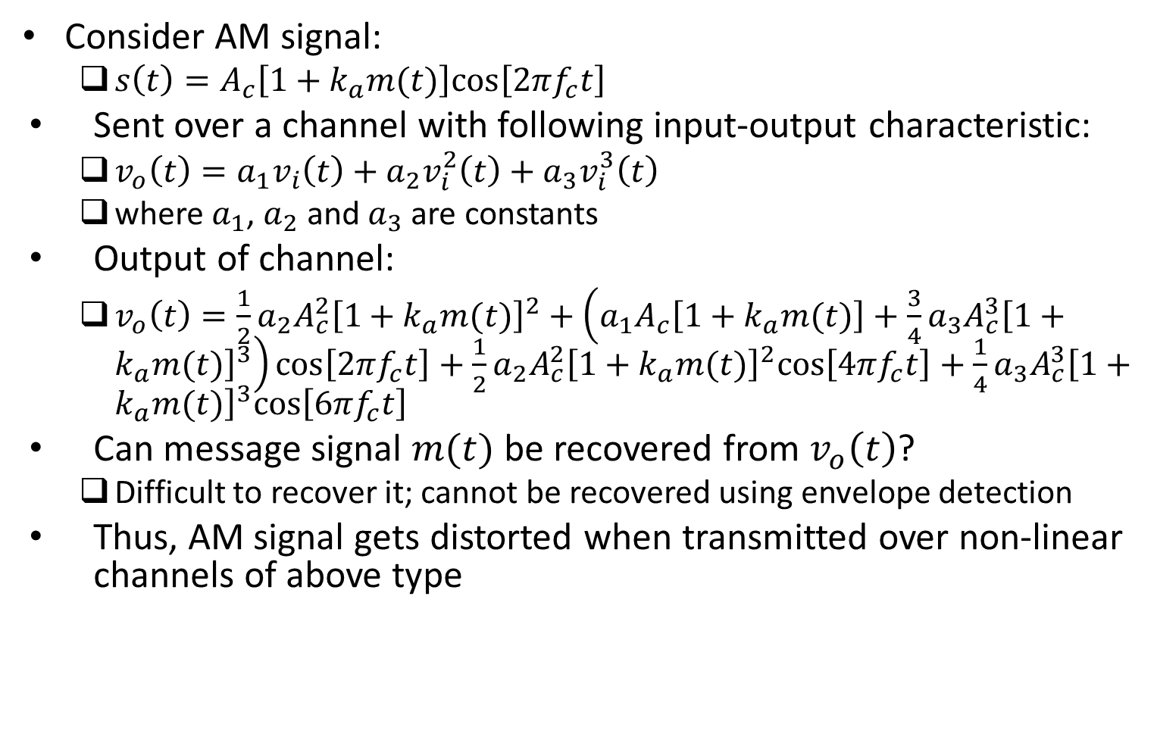
Effect of Sending AM Signal over Non-linear Channel
Consider AM signal:
$s\left(t\right)=A_{c}\left[1+k_{a}m(t)\right]cos\left[2πf_{c}t\right]$
Sent over a channel with following input-output characteristic:
$v_{o}\left(t\right)=a_{1}v_{i}\left(t\right)+a_{2}v_{i}^{2}\left(t\right)+a_{3}v_{i}^{3}\left(t\right)$
where $a_{1}$, $a_{2}$ and $a_{3}$ are constants
Output of channel:
$v_{o}\left(t\right)=\frac{1}{2}a_{2}A_{c}^{2}{\left[1+k_{a}m(t)\right]}^{2}+\left(a_{1}A_{c}\left[1+k_{a}m(t)\right]+\frac{3}{4}a_{3}A_{c}^{3}{\left[1+k_{a}m(t)\right]}^{3}\right)cos\left[2πf_{c}t\right]+\frac{1}{2}a_{2}A_{c}^{2}{\left[1+k_{a}m(t)\right]}^{2}cos\left[4πf_{c}t\right]+\frac{1}{4}a_{3}A_{c}^{3}{\left[1+k_{a}m(t)\right]}^{3}cos\left[6πf_{c}t\right]$
Can message signal $m(t)$ be recovered from $v_{o}\left(t\right)$?
Difficult to recover it; cannot be recovered using envelope detection
Thus, AM signal gets distorted when transmitted over non-linear channels of above type

Slide 27
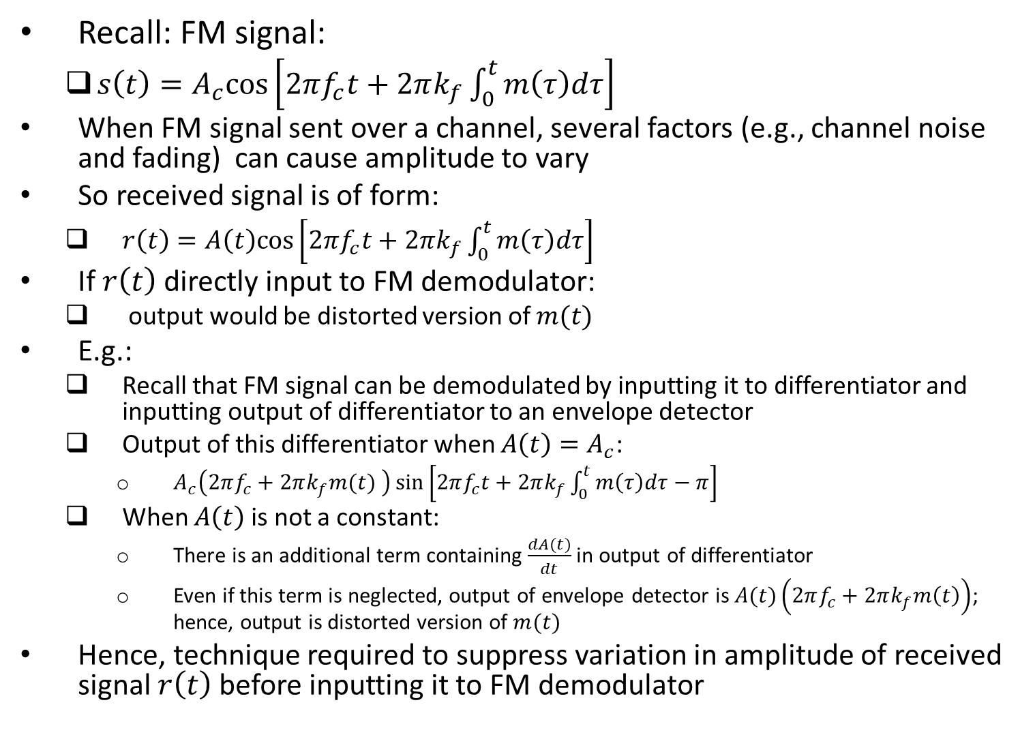
Amplitude Variations in FM Signal
Recall: FM signal:
$s\left(t\right)=A_{c}cos\left[2πf_{c}t+2πk_{f}\int_{0}^{t}{m\left(τ\right)dτ}\right]$
When FM signal sent over a channel, several factors (e.g., channel noise and fading) can cause amplitude to vary
So received signal is of form:
$r\left(t\right)=A\left(t\right)cos\left[2πf_{c}t+2πk_{f}\int_{0}^{t}{m\left(τ\right)dτ}\right]$
If $r\left(t\right)$ directly input to FM demodulator:
output would be distorted version of $m(t)$
E.g.:
Recall that FM signal can be demodulated by inputting it to differentiator and inputting output of differentiator to an envelope detector
Output of this differentiator when $A\left(t\right)=A_{c}$:
$A_{c}\left(2πf_{c}+2πk_{f}m(t) \right)\sin\left[2πf_{c}t+2πk_{f}\int_{0}^{t}{m\left(τ\right)dτ}−π\right]$
When $A\left(t\right)$ is not a constant:
There is an additional term containing $\frac{dA(t)}{dt}$ in output of differentiator
Even if this term is neglected, output of envelope detector is $A(t)\left(2πf_{c}+2πk_{f}m\left(t\right)\right)$; hence, output is distorted version of $m(t)$
Hence, technique required to suppress variation in amplitude of received signal $r\left(t\right)$ before inputting it to FM demodulator

Slide 28
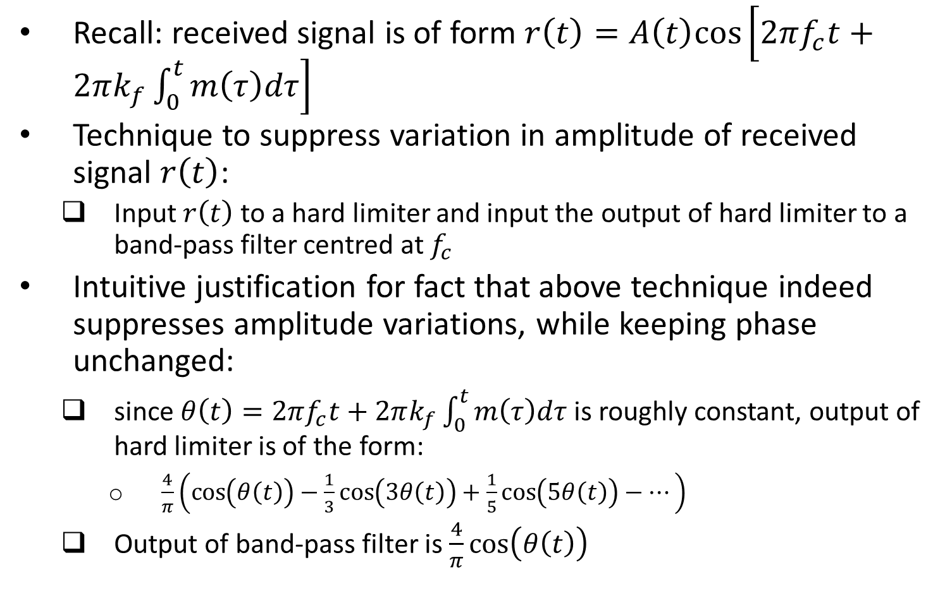
Amplitude Variations in FM Signal (contd.)
Recall: received signal is of form $r\left(t\right)=A\left(t\right)cos\left[2πf_{c}t+2πk_{f}\int_{0}^{t}{m\left(τ\right)dτ}\right]$
Technique to suppress variation in amplitude of received signal $r\left(t\right)$:
Input $r\left(t\right)$ to a hard limiter and input the output of hard limiter to a band-pass filter centred at $f_{c}$
Intuitive justification for fact that above technique indeed suppresses amplitude variations, while keeping phase unchanged:
since $θ\left(t\right)=2πf_{c}t+2πk_{f}\int_{0}^{t}{m\left(τ\right)dτ}$ is roughly constant, output of hard limiter is of the form:
$\frac{4}{π}\left(\cos\left(θ\left(t\right)\right)−\frac{1}{3}\cos\left(3θ\left(t\right)\right)+\frac{1}{5}\cos\left(5θ\left(t\right)\right)−…\right)$
Output of band-pass filter is $\frac{4}{π}\cos\left(θ\left(t\right)\right)$

